Slide 1

CUSTOMER CHURN ANALYSIS
USING R
Presented By:-
Mudeet Jain Kartik Sethi
10316210072 10316210054
CSE-B CSE-B

Slide 2

MAJOR PROJECT
Project Mentor:
DR. PUNEET GOSWAMI
HOD:
DR. AJAY SHARMA

Slide 3
TOPICS
WHAT IS CUSTOMER CHURN ANALYSIS
IMPORTANCE OF CHURN ANALYSIS
THINGS WE LEARN
OBJECTIVE
R PROGRAMMING LANGUAGE WITH ITS ADVANTAGES
PROPOSED METHODOLOGY
CONFUSION MATRIX
ACCURACY AND KAPPA STATISTICS
DESIGN STEPS
RESULTS FROM VARIOUS PREDICTIVE MODELS
CONCLUSION AND FUTURE SCOPE

Slide 4

What is Customer Churn Analysis?
Churn means loss of customers of the company.
The customer churn analysis feature helps us identify and focus on higher value customers and determine what actions typically precede a lost customer or sale, and better understand highly important factors that leads to churn.
For e.g. In telecom sector, ‘churn’ means customer’s decision to change from one service provider to another.

Slide 5
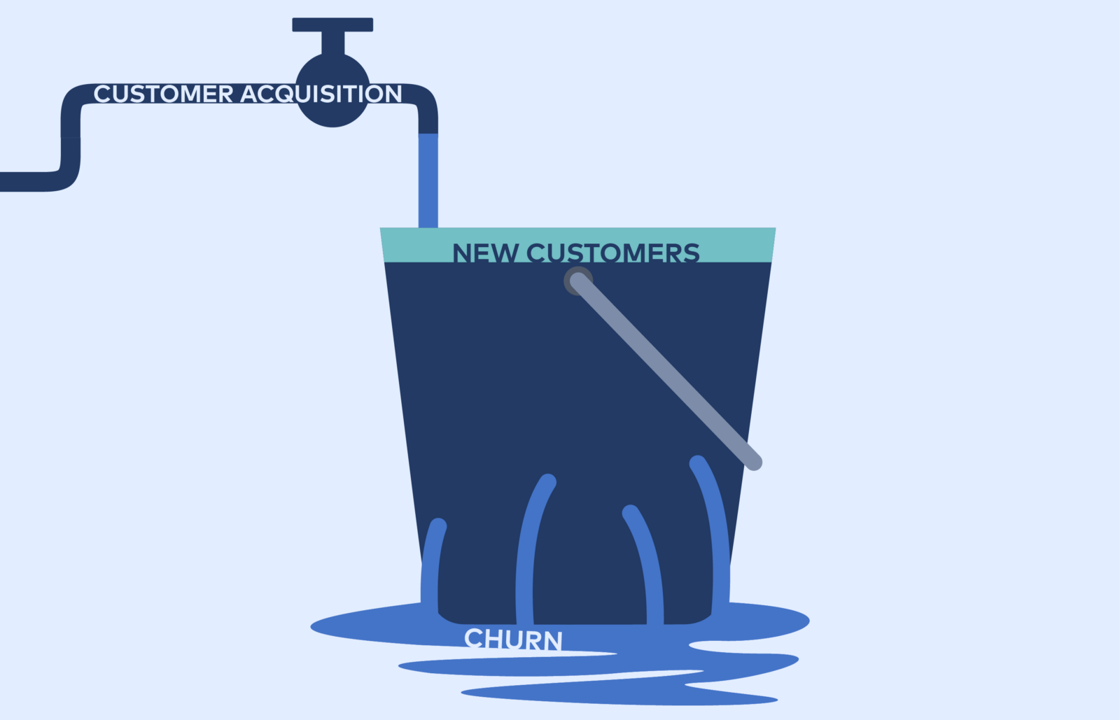
Why Churn Analysis?
Customer churn is a measure of number of customers moving out of a collective over a specific period of time
Keeping an existing customer is much cheaper (5 -10 times) than acquiring a new customer.
Retaining customers is one of the most critical challenges in the maturing mobile telecommunications service industry.

Slide 6

Things We Learn
Who are the customers likely to churn?
What are the factors mainly responsible for churn?
What type of recommendations can be provided to the organization?
Who are the most valuable customers?
How valid is the churn prediction model?

Slide 7
OBJECTIVE
The objective of this problem is to build a churn prediction model which can identify churner customers and non-churner customers from a large dataset. The project aims to take data from a telecommunication company and use it to train classification models that will be able to predict future churn behavior of the customers.
This prediction model is based on Data Mining (DM) techniques using R that predicts the results of churn customers in various unique pattern visualizations.

Slide 8

R Programming Language
R is a powerful statistical programming tool which can represent the dataset graphically with respect to different parameters and it also uses different packages available. R programming language is best for statistical, data analysis and machine learning. We can use it anywhere. It’s platform- independent, so we can apply it to all operating system. By using R, we can create any form of statistics and data manipulation. The R tool has represented the large dataset churn in form of graphs which depicts the outcomes in various unique pattern visualizations. R has some statistical features also:
Basic Statistics – Mean, variance, median.
Static graphics– Basic plots, graphic maps.
Probability distributions – Beta, Binomial.

Slide 9
Advantages of R Language
Many quantitative analysts use R as their programming tool. Hence, R helps in data importing and cleaning, depending on what manner of strategy you are using on.
R is best for data Science because it gives a broad variety of statistics. In addition, R provides the environment for statistical computing and design.
Better visualization since it has packages like plot3D, boxplots, barplots, shiny dashboard.
Feature Selection
Better decision making
Very powerful for finance
Can handle large dataset
Simple to learn and use as there are predefined library that have to be installed and use directly.

Slide 10
Job Roles in R
Financial firms
Retail organizations
Banks
Healthcare organization
R data scientist
Data-Scientist (IT)
Analyst manager
Senior data analyst
Business analyst
Analyst consultant

Slide 11
List of Companies Using R
TechCrunch
Google
Facebook
Genpact
Bing
Accenture
Wipro
Mozilla
ANZ
The New York Times

Slide 12




Use Cases of R Language
Basically, Facebook uses R to update status and its social network graph. Also, for predicting colleague interactions with R, Facebook uses it.
R is part of Twitter’s Data-Science toolbox for sophisticated statistical modelling.
Ford relies on Hadoop. Also, R for statistical analysis and data-driven decision support.
Basically, Google uses R to calculate ROI on advertising campaigns, to predict economic activity. Also, to improve the efficiency of online advertising.

Slide 13
Proposed Methodology
To identify the customers, we need to have a database with data about the previous customers that churned. The database has 2 parts, one part will be the training set. This will be used to create the model. The second part will be the testing set which will be used to evaluate our model. In this, we target mainly those customers with high probability to churn. This probability is given by our model.
We can estimate our train with 3 different models.
Decision Tree
Random Forest
Logistic Regression Model

Slide 14
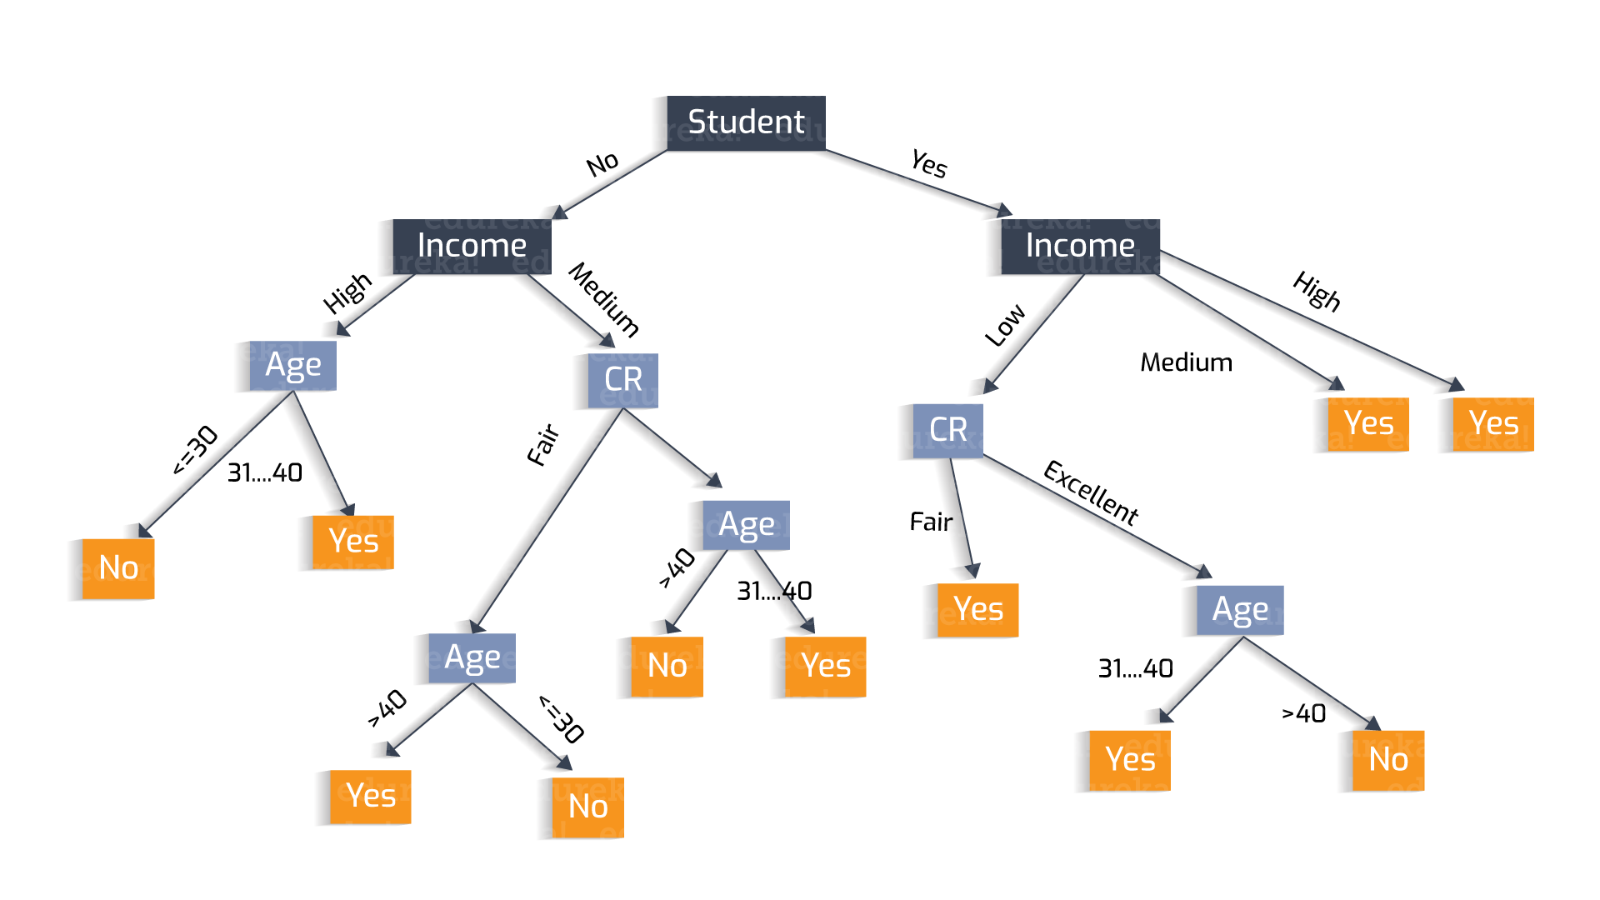
DECISION TREE
Decision tree is a graph to represent choices and their results in form of a tree. The nodes in the graph represent an event or choice and the edges of the graph represent the decision rules or conditions.
Syntax: ctree(formula, data)
formula is a formula describing the predictor and response variables.
data is the name of the data set used.

Slide 15
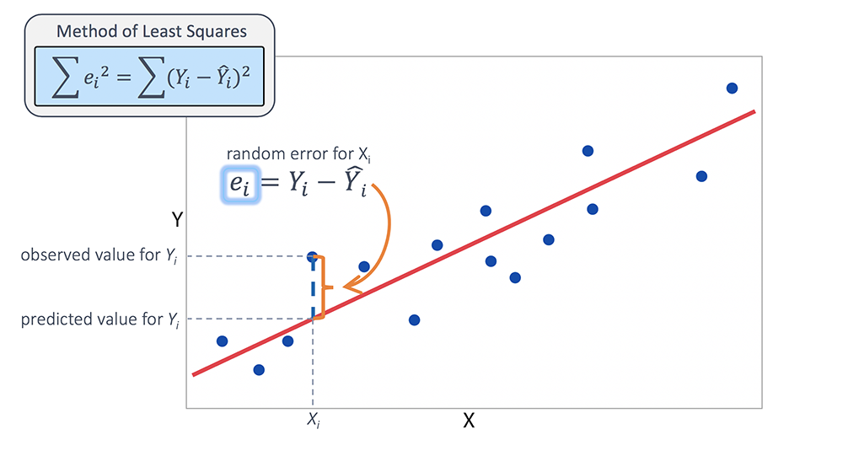
Logistic Regression Model
The Logistic Regression model is a model in which dependent variable has categorical values such as True/False or 0/1. It measures the probability of a binary response as the value of response variable based on the mathematical equation relating it with the predictor variables.
The glm() function is to create the regression model.
Syntax: glm(formula, data, family)

Slide 16
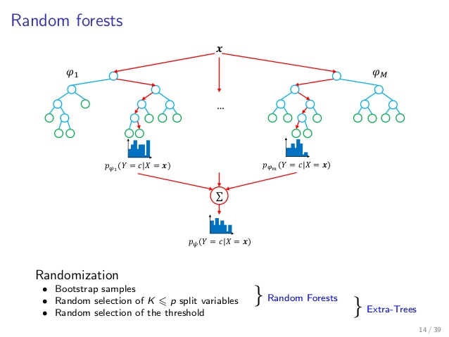
RANDOM FOREST
In the random forest approach, a large number of decision trees are created. Every observation is given into every decision tree. An error estimate is made for the cases which were not used while building the tree. The R package "randomForest" is used to create random forests.
Syntax: randomForest(formula, data)
formula is a formula describing the predictor and response variables.
data is the name of the data set used.

Slide 17

CONFUSION MATRIX
A confusion matrix is a table that is often used to describe the performance of a classification model (or “classifier”) on a set of test data for which the true values are known. It allows the visualization of the performance of an algorithm.
Confusion Matrix gives the following values for every prediction model:
Accuracy
Kappa Statistics

Slide 18
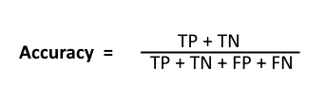
ACCURACY
Classification Rate or Accuracy is given by the relation:
True Positive (TP): Observation is positive, and is predicted to be positive.
False Negative (FN): Observation is positive, but is predicted negative.
True Negative (TN): Observation is negative, and is predicted to be negative.
False Positive (FP): Observation is negative, but is predicted positive.

Slide 19
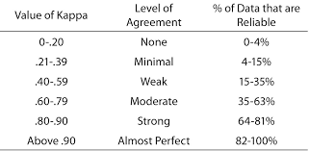
KAPPA STATISTICS
Cohen's kappa coefficient (κ) is a statistic which measures inter-rater agreement for qualitative (categorical) items. It is generally thought to be a more robust measure than simple percent agreement calculation, as κ takes into account the possibility of the agreement occurring by chance.

Slide 20
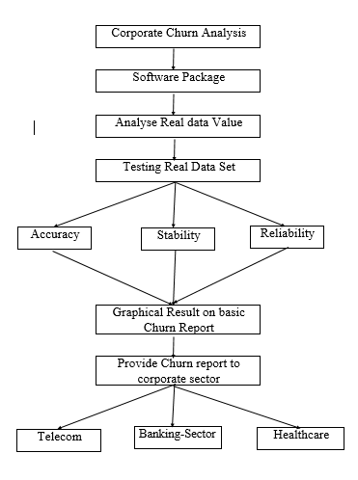
FLOW CHART

Slide 21
DESIGN STEPS
Our framework consists of the following five modules:
Data Acquisition
Data Preparation
Data Pre-processing
Data Extraction
Decision Making

Slide 22
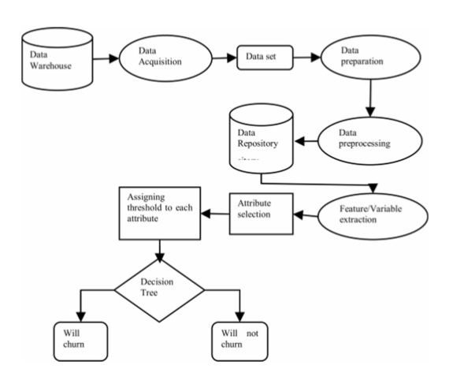
CHURN PREDICTION FRAMEWORK

Slide 23
METHODS
Data Acquisition:Acquiring data from the Telecom industry is a big task because of the fear of misusing it. The data set for this study acquired from the KDD from Kaggle. It is used to analyse the marketing tendency of customers from the large databases from the French Telecom company.
Data Preparation: Since the dataset acquired cannot be applied directly to the churn prediction models, so aggregation of data is required where new variables are added to the existing variables by viewing the periodic usage behaviour of the customers. These variables are very important in predicting the behaviour of customers in advance as they contain critical information used by the prediction models.

Slide 24
METHODS
Data Pre-processing: Data pre-processing is the most important phase in prediction models as the data consists of ambiguities, errors, redundancy which needs to be cleaned beforehand. The data gathered from multiple sources first is aggregated and then cleaned as the complete data collected is not suitable for modelling purposes. The 15 records with unique values do not have any significance as they do not contribute much in predictive modelling. Fields with too many null values also need to be discarded.
Data Extraction: The attributes are identified for classifying process. In our work, we have worked with numerical and categorical values.
Decision: The rule set will let the subscribers identify and classify in the different categories of churners and non-churners by setting a particular threshold value.

Slide 25
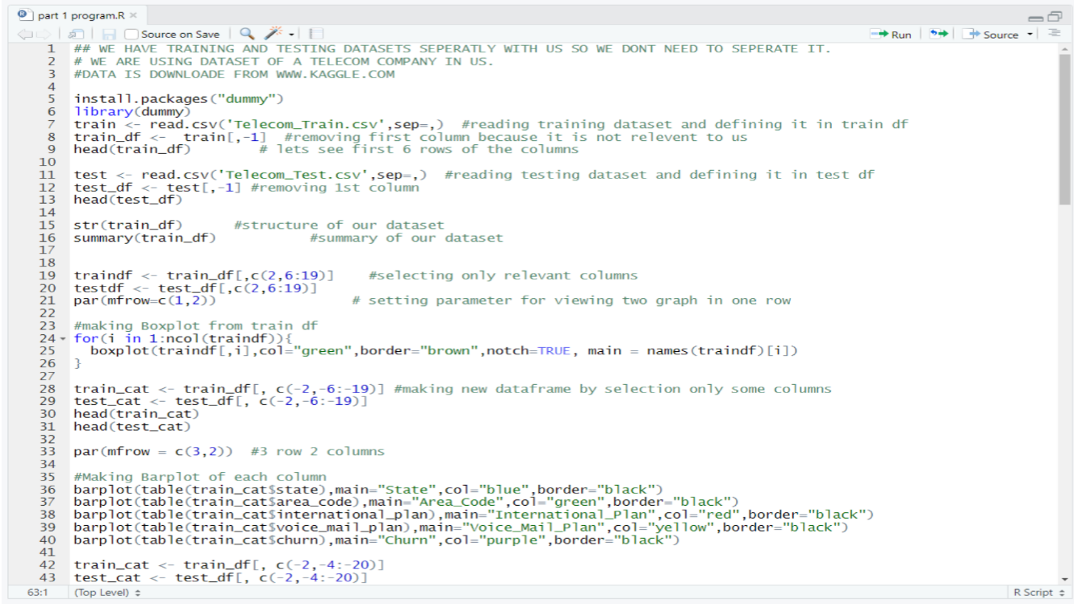
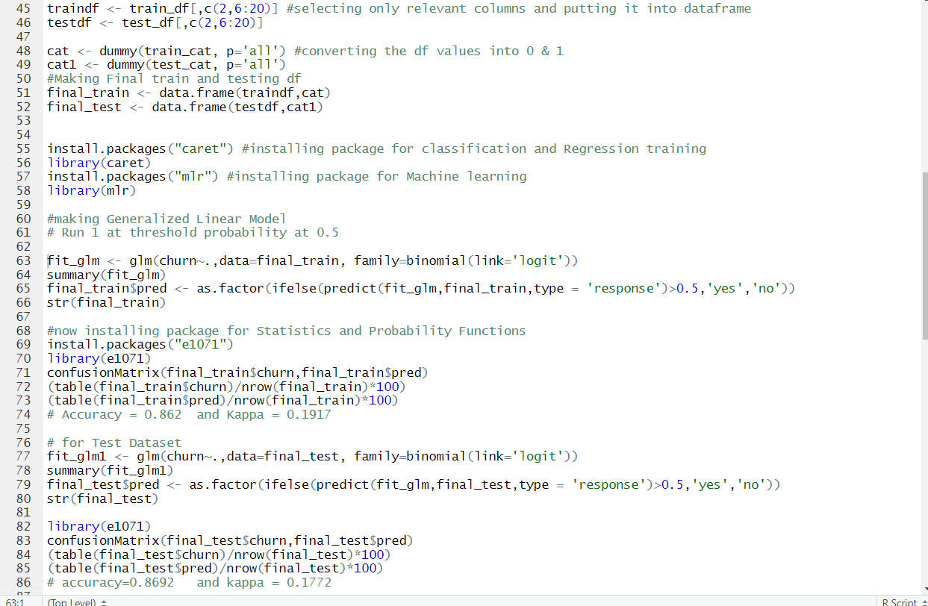
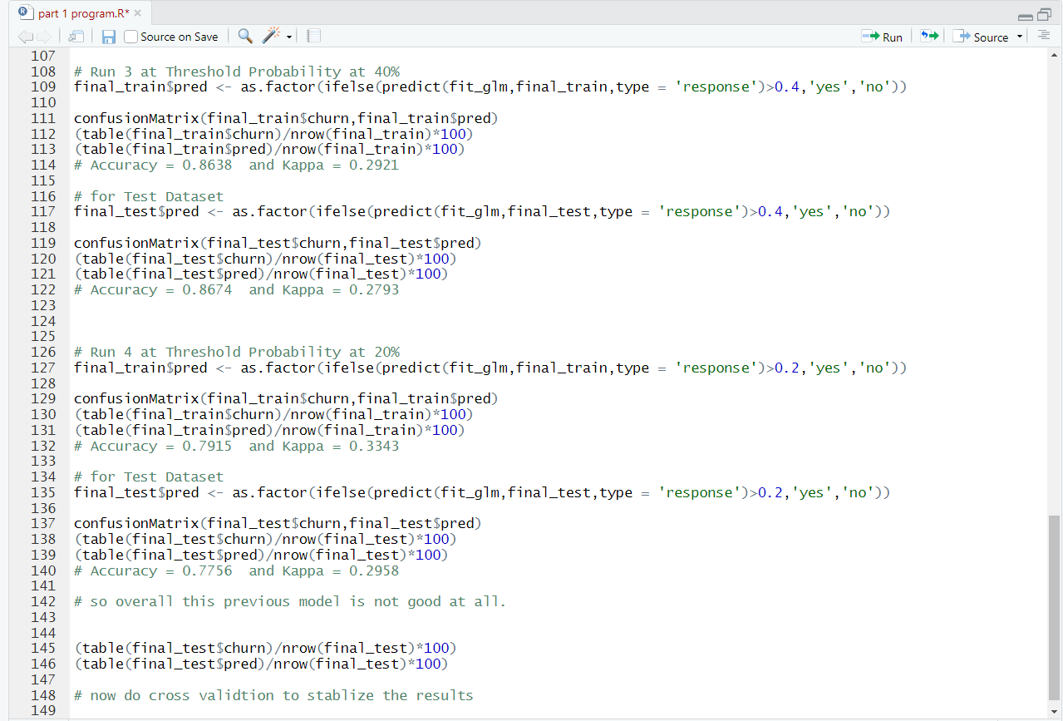
SOURCE CODE

Slide 26
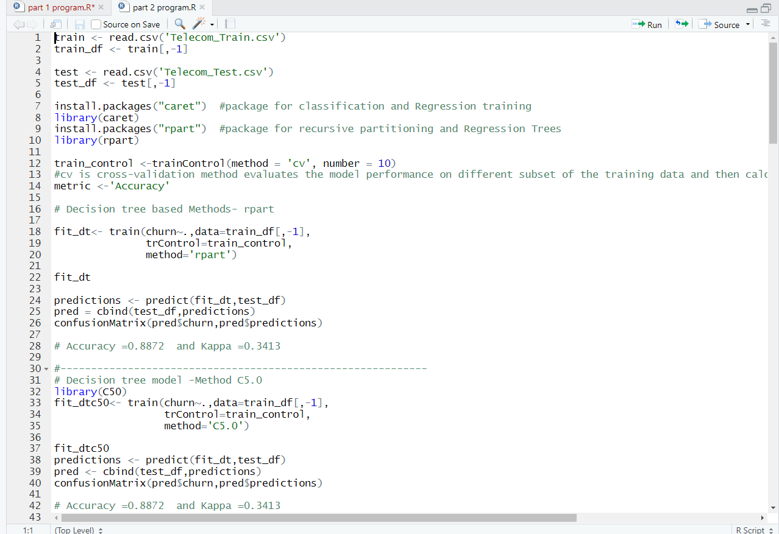
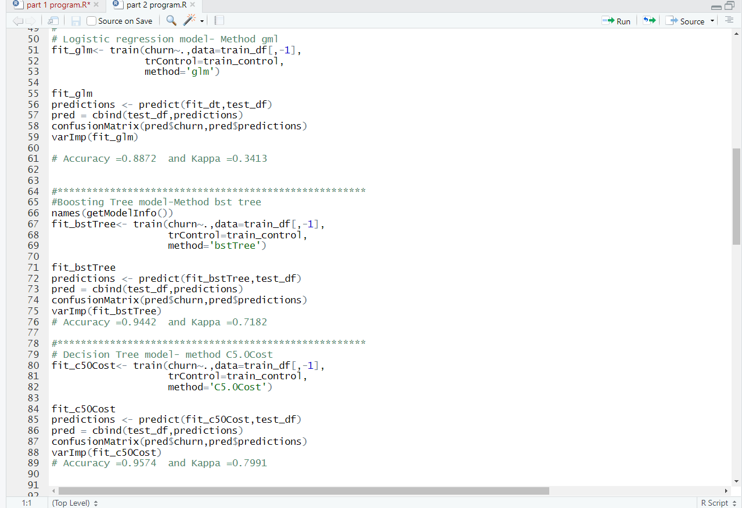
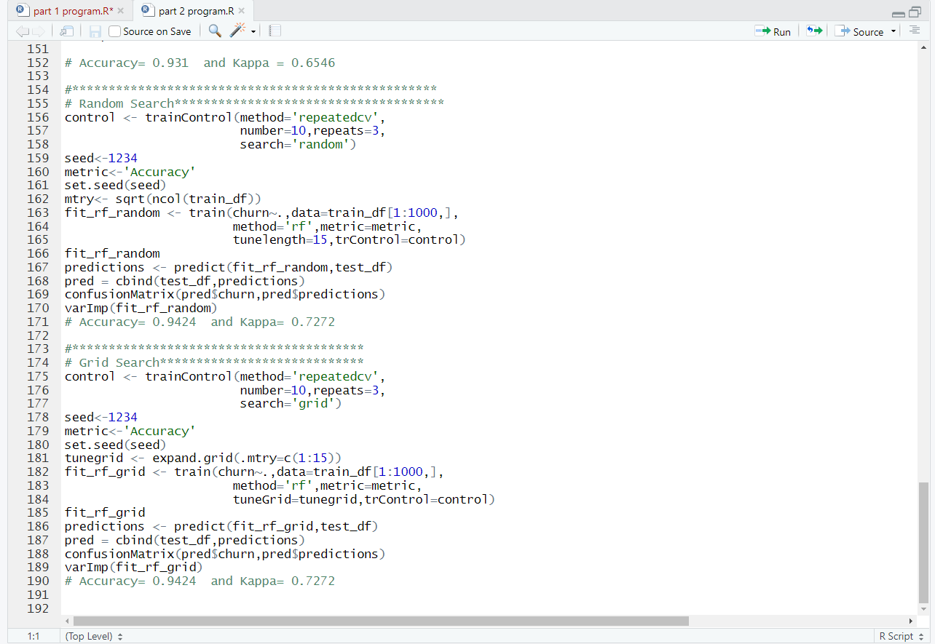
SOURCE CODE (CROSS-VALIDATION)

Slide 27
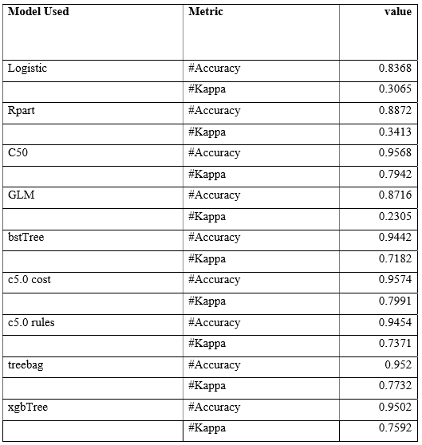
Comparison of Various Prediction Model used in Churn Analysis

Slide 28
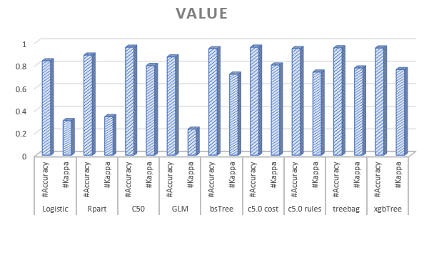
Results From Various Prediction Models (BAR GRAPH)

Slide 29
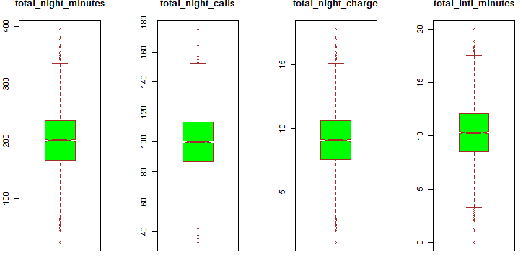
Results From Various Prediction Models (BOX PLOT)

Slide 30
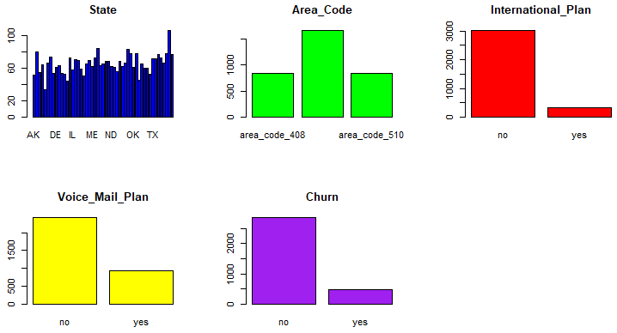
Visualization Patterns

Slide 31
FUTURE SCOPE
The future scope of this project will be to acquire nearly 100% accuracy with good kappa value using some other enhanced and developed formula with further calculations so that churn analysis become easier and can be used in some advanced fields like medical fields. The proposed model can be further enhanced, if the processes are working in parallel.

Slide 32
CONCLUSION
Telecommunication industry has suffered from high churn rates and immense churning loss. Although the business loss is unavoidable, but still churn can be managed and kept in an acceptable level. The churn prediction model helps in better decision making. After analyzing various predictive models, we found that the accuracy achieved with decision tree using C5.0 Cost method is far much higher (above 86 %) than the logistic regression technique(less than 80%) which clearly states that decision tree is an efficient technique.

Slide 33
THANK YOU

